Slide 1
Specialization 501 "Graduate Level"
Professor James Wren, NBLSC President
David Rapoport, NBLSC Board
&
ABA 2011 National Specialization Roundtable April 1, 2011

Slide 2
Understanding Where We Are

Slide 3
Where We Are -- overview
Objective of Legal Board Certification
Development of Board Certification in Medicine
Brief History of Legal Board Certification
Understanding the Legal Market
Legal Issues Relating to Board Certification
How the Public Selects Lawyers

Slide 4
  Objective of Legal Board Certification

Slide 5
Objective of Legal board certification
Primary Objective:
Provide reliable means for the public to find attorneys specialized in relevant field
Supporting Assumption:
The legal profession as a whole benefits as the public is better served and informed

Slide 6
Attorney Board Certification program goals According to the north Carolina’s Board of Legal Specialty Certification
First, the program assists in the delivery of legal services to the public by identifying to the public those lawyers who have demonstrated special knowledge, skill, and proficiency in a specific field. By identifying these lawyers, members of the public can more closely match their needs with available services.
Second, the legal specialization program seeks to improve the competency of members of the bar by establishing an additional incentive for lawyers to participate in continuing legal education and to meet other requirements of specialization.

Slide 7
  Development of Board Certification in Medicine

Slide 8
Board Certified Physicians
82% Of Total
Board Certification: Medical v. Legal
Board Certified Attorneys
3% of Total

Slide 9
Key development phases in certification
Phase One:
Development of certifying organizations
Phase Two:
Development of institutional support
Phase Three:
Development of peer and public expectations

Slide 10
  Brief History of Legal Board Certification

Slide 11
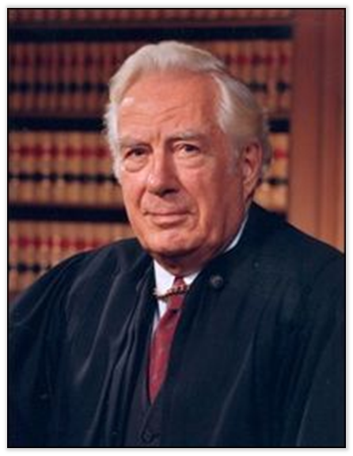
1973
“Some system of certification for trial advocates is an imperative and long overdue step."

Slide 12
Understanding the Legal Market
Size of legal specialty certification …
        generally
        by major states
        by practice areas

Slide 13
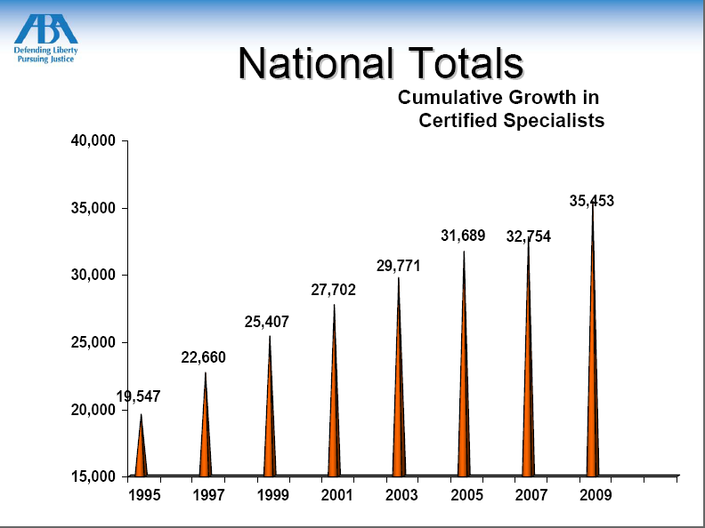

Slide 14
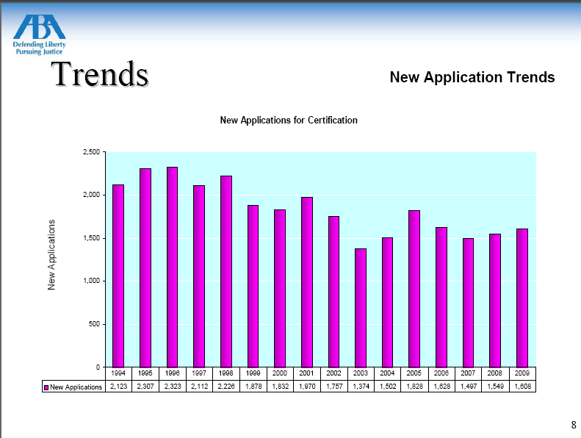

Slide 15
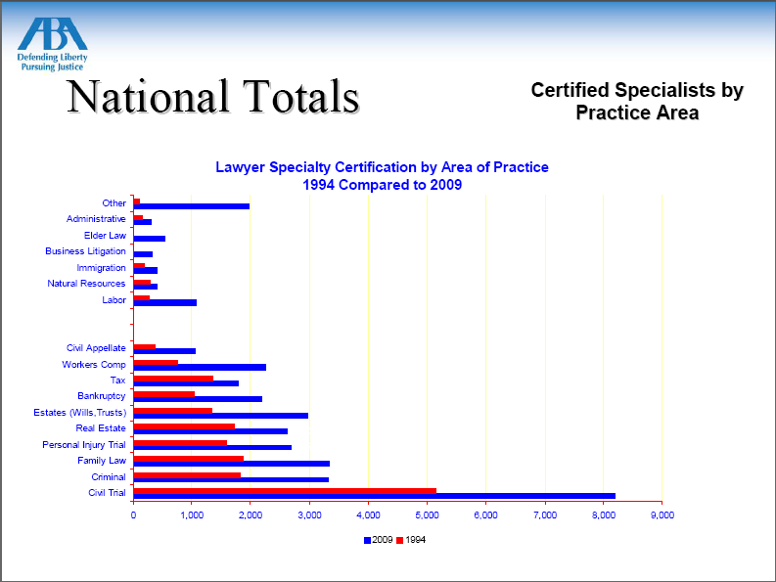

Slide 16
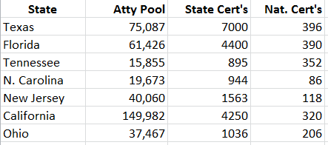
Leading State Programs

Slide 17
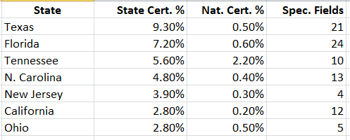
Leading State Programs

Slide 18
Legal Issues Relating to attorney Board Certification

Slide 19
How the Public Selects Lawyers

Slide 20
Most important factors (2000 survey)
#1 Trust (88%)
#2 Specialization (83%)
#3 Cost (59%)

Slide 21
Most important factors (2007 survey)
Open-Ended Inquiry of Important Hiring Factors
#1 Competence, knowledge, experience (42%)
#2 Honesty (36%)
#3 Winning record, cases / trials won (12%)
#4 Reputation (9%)
#4 Fees charged (9%)
#6 Committed, listens, cares (8%)

Slide 22
Most important factors (2007 survey)
Ranking of List of 12 Most Important Factors
#1 Attorney specializes in area needed (74%)
#2 Located in your town (71%)
#3 Trial experience (65%)
#4 Board certified (54%)
#5 Fees charged (48%)
#6 Referred by family member or friend (47%)

Slide 23
Public awareness of board certification
“Have you heard of attorneys being certified in a specific area of law?”
81% Yes
19% No
(Texas Board of Legal Specialization 2007 Consumer Survey)

Slide 24

Understanding Possible Routes Going Forward
Getting the Message to
The Public and …
Lawyers and Judges

Slide 25
Is your attorney board certified?
Mine is boring enough without being certified.

Slide 26
Possible future routes -- overview
The Challenge of Properly Informing the Public
The Challenge of Overcoming Resistance in the Profession to Board Certification
Enhanced Collaboration Between Board Certifying Organizations
Enhanced Collaboration Between Board Certifying Organizations and Law Schools
Potential Collaborative Strategy With One or More For-Profit Organizations

Slide 27
The Challenge of Properly Informing the Public
positives
challenges
  The message is in the public interest;
  The message is easy to understand; and
  The messengers are highly credible.
  The public is largely unaware of attorney board certification; and
  The certification boards have limited funds for marketing.

Slide 28
The Challenge of Overcoming Resistance in the Profession to Board Certification
positives
challenges
  Board certification is clearly in the public interest;
  There are success models for board certification programs; and
  Board certification is supported by important segments of the bench and bar.
  Many states still have restrictive limitations pertaining to board certification; and
  Most lawyers are not board certified and some may be reluctant to support board certification for competitive reasons.

Slide 29
Enhanced Collaboration Between
Board Certifying Organizations
  Progress Since 2010 ABA Roundtable
  Possibilities and obstacles for sustained marketing of legal board certification generally
  Possibilities and obstacles for a consumer-oriented website covering all board certified attorneys nationally

Slide 30

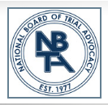

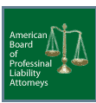











Slide 31
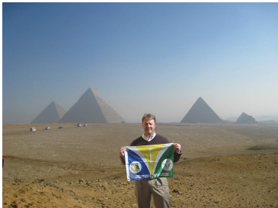



Slide 32
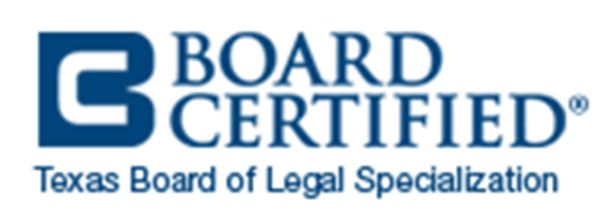
Progress Since 2010 ABA Roundtable
2010 Roundtable Session Reports … Task Force on Public Outreach
Imperative to market to attorneys and the public to tell the benefits.
Have uniformity with logo or even attorneys can identify themselves with initials behind name.
Everyone liked Texas logo of simple “Board Certified.”
Frustration that have been talking about for years but nothing has been done.
We want to stay in communication through listserve throughout year.

Slide 33
Progress Since 2010 ABA Roundtable
Quarterly Conference Calls??

Slide 34
Possibilities and Obstacles for Sustained Marketing of Legal Board Certification Generally

Slide 35
Possibilities and Obstacles for a Consumer-Oriented Website Covering All Board Certified Attorneys Nationally

Slide 36
Enhanced Collaboration Between Board Certifying Organizations and Law Schools

Slide 37
Potential Collaborative Strategy in Conjunction with One or More For-Profit Organizations

Slide 38
Questions, Comments and Discussion

